Slide 1

FINAL PROJECT
Online Course Recommender
Ümmühan DEMIR
Ironhack DAFT OCT 2021

Slide 2
Personal Interest
Lifetime learner
I like giving recommendations
There are a lot of choices

Slide 3
Methods and Process
Getting the data
Cleaning the data
Text analysis
Apply some models
Choose the model
Build the recommender
web scraper extension
webscraping coursera.org/learn
obtaining features
1551 rows, 12 columns

Slide 4
Methods and Process
Getting the data
Cleaning the data
Text analysis
Apply some models
Choose the model
Build the recommender
restrict the data
regular cleaning process

Slide 5
Methods and Process
Getting the data
Cleaning the data
Text analysis
Apply some models
Choose the model
Build the recommender
obtain and clean the corpus
apply nltk procedures

Slide 6
Methods and Process
Getting the data
Cleaning the data
Text analysis
Apply some models
Choose the model
Build the recommender
For feature extraction:
Tfidf
Countvectorizer
For similarity analysis:
Cosine similarity
KNN – Euclidean distance

Slide 7
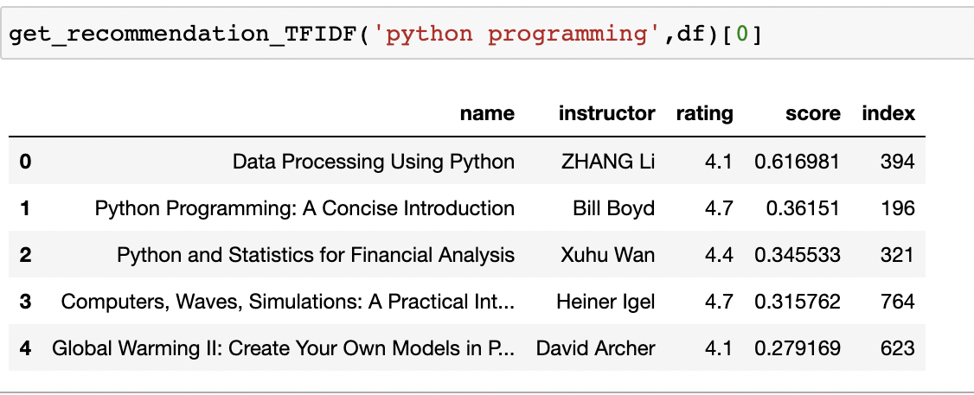
Tfidf – Cosine similarity

Slide 8
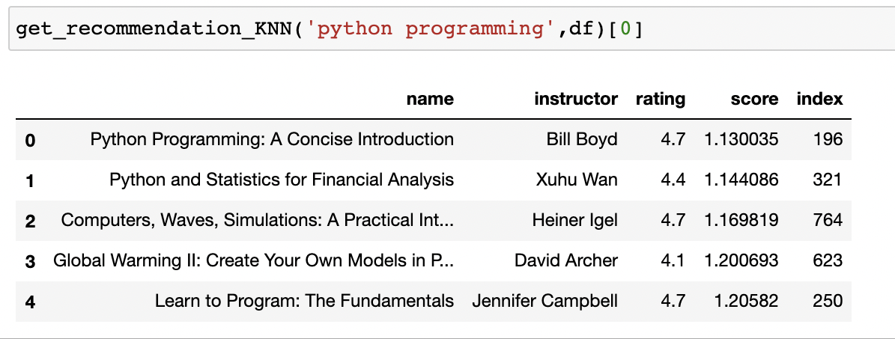
Tfidf – KNN

Slide 9
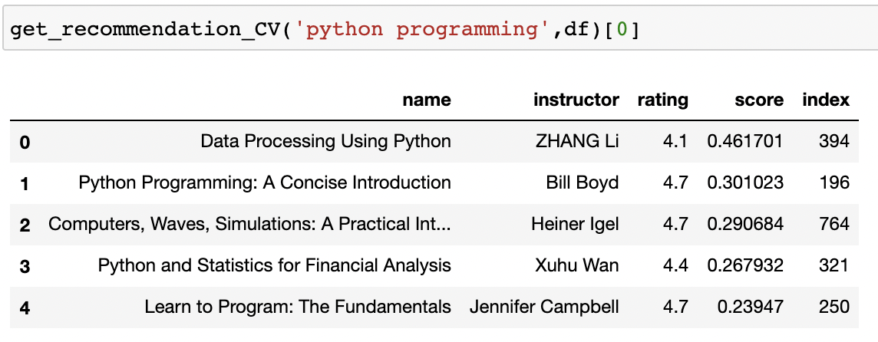
Count Vectorizer – Cosine similarity

Slide 10
Recommender

Slide 11
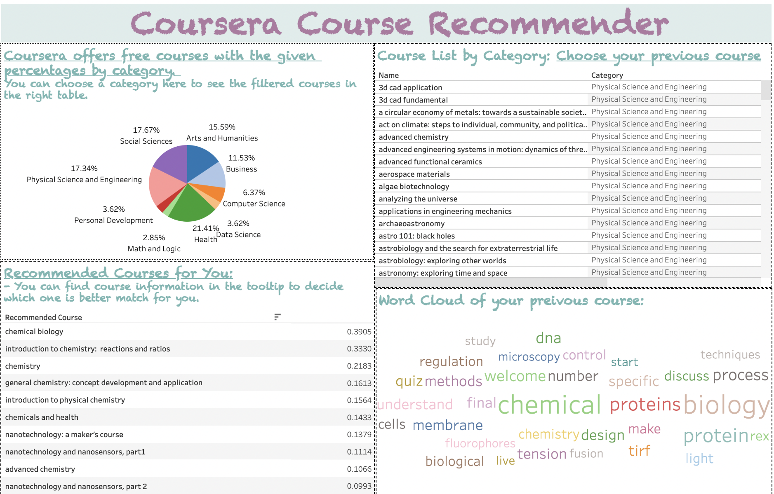
Tableau Version:

Slide 12
Future Steps
Collect more courses from different platforms or paid courses in Coursera
Expand the stop words set accordingly
Build a prettier interface (???)

Slide 13
Thanks!

